Slide 1
Lab 08 Creating Interactive Menus and ActionBars
By
M.Zakir Khan

Slide 2
In almost all applications we encounter menus that display options in the form of menus items. Choosing a menu item results in the initiation of the desired task. ActionBar is a widget that replaces the title bar at the top of an Activity displaying navigation and important functionality of an application. It provide a constant UI of an application. Action bar is also commonly used to provide a quick link to an application’s home.

Slide 3
Menus and their Types
Android SDK support three types of menus:
Option, submenu and Context.
Option Menu--- Also know as Activity menu, this menu is displayed when a MENU button is clicked. In an option menu, the menu items are displayed in the form of text, checkbox and radio buttons.
Icon Menu
Expanded Menu
Submenu--- Submenu refer to the menu that displays more detailed or specific menu options when a menu item is selected. A submenu is displayed as a floating window showing all of its menu options, the name of the submenu is shown in the header bar and each menu option is displayed with its full text, checkbox and radio button
Context Menu--- The context menu is displayed when we tap-and-hold on the concerned View or when a user holds the middle D-pad button or press the track ball.

Slide 4
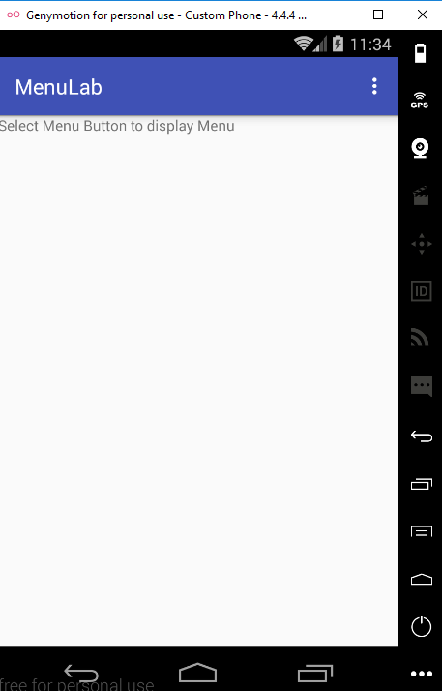
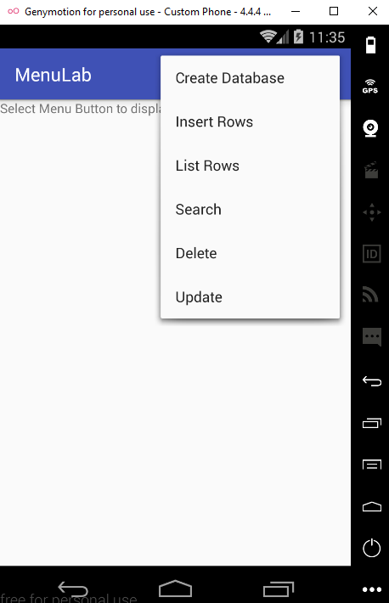
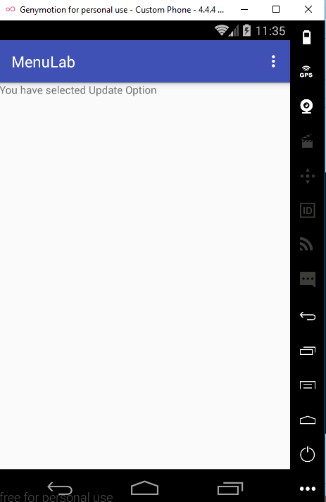
Screen Shot

Slide 5
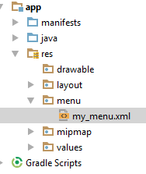
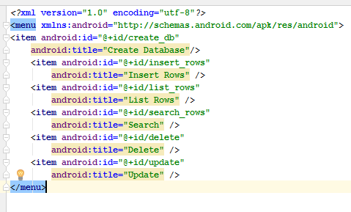
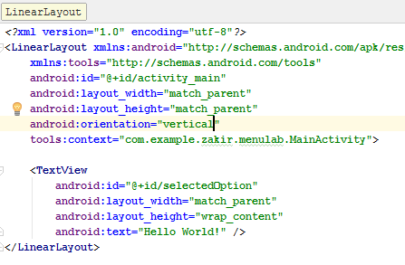
Default Menu + Creating Menus through XML

Slide 6
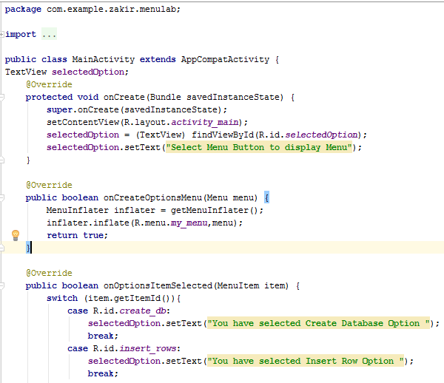
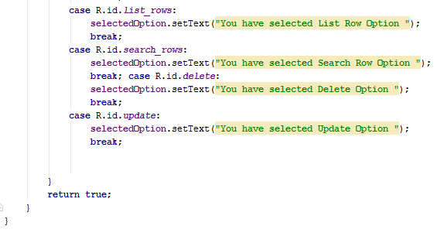
Java code

Slide 7
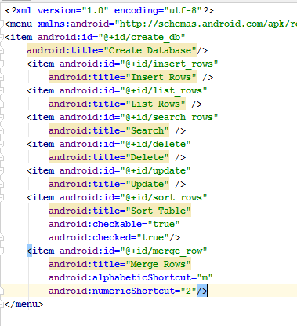
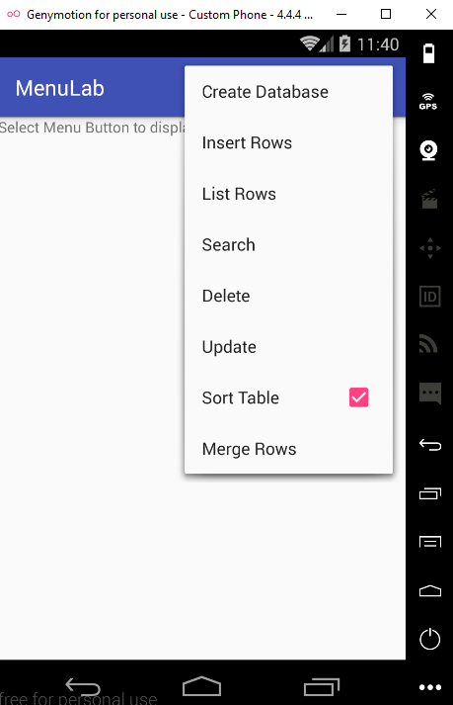
Defining Checkboxes and Shortcut

Slide 8

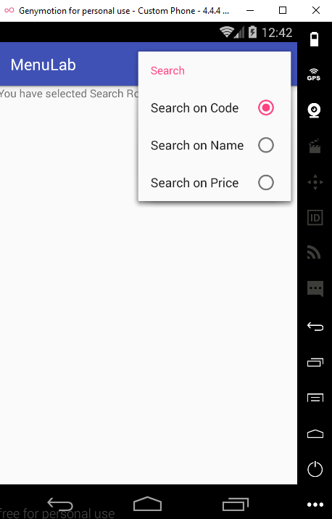
Adding Submenu Screen shot

Slide 9
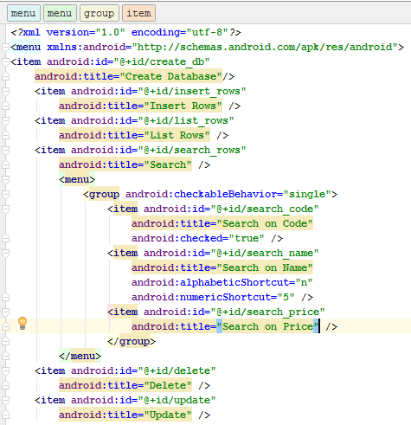
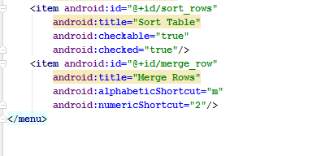
Adding Submenu Xml code

Slide 10
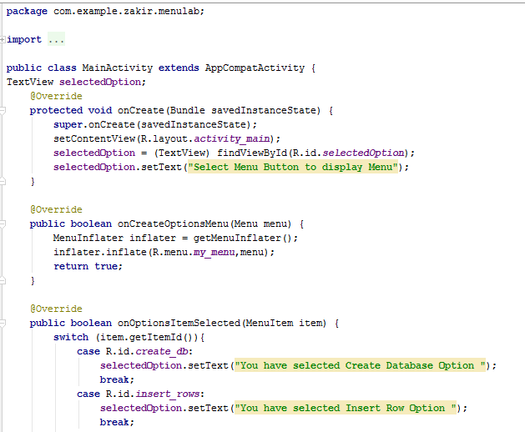
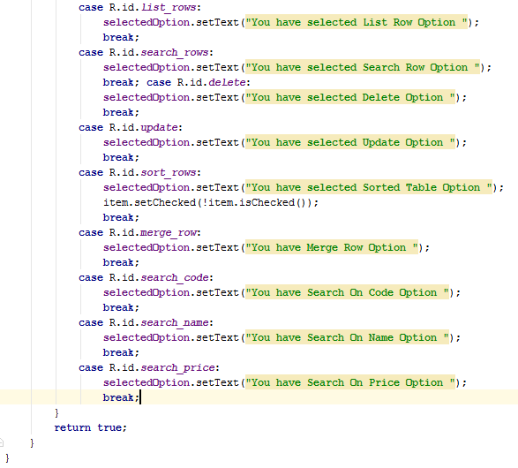
Adding Submenu Java code

Slide 11
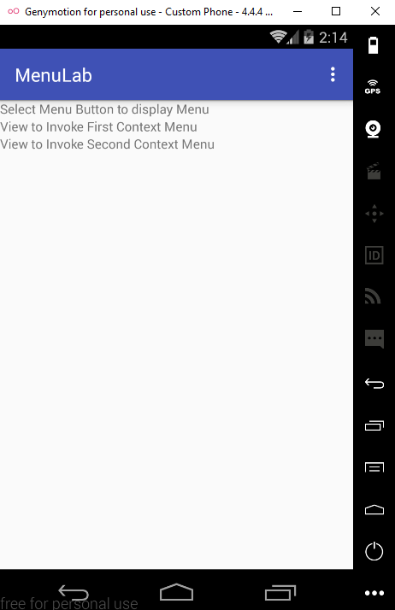
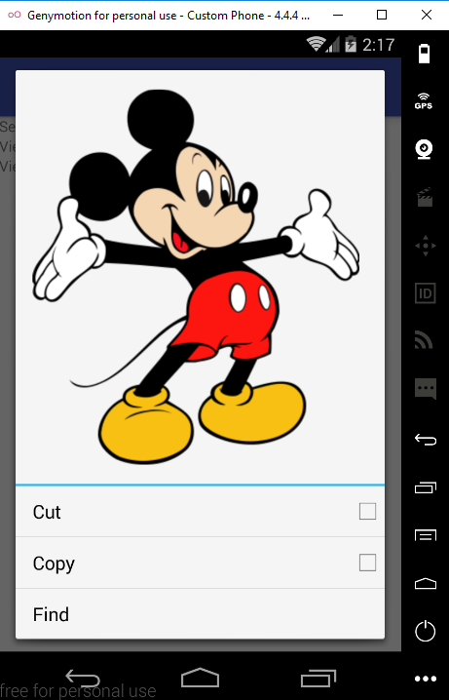
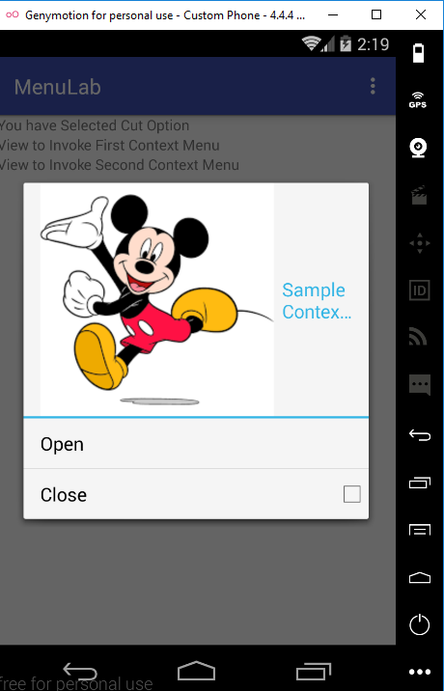
Context Menu
When emulator run, Step1: first of all 3 textview will show as shown in left figure 0ne. Step2: When you click and pressed the second textview then the second figure will shown. Step3 when you click on Third Textview then it will show like figure three.

Slide 12
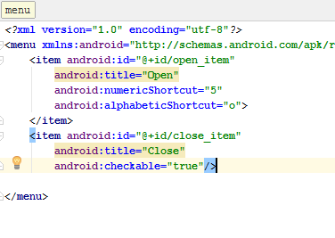
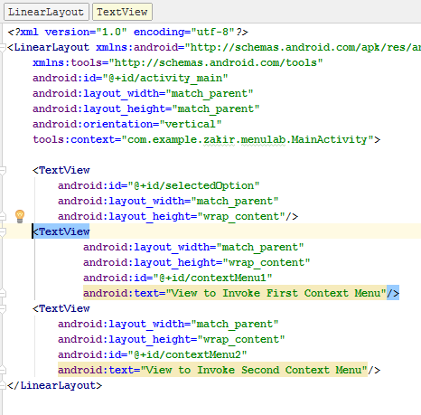
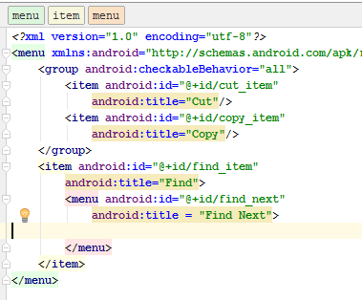
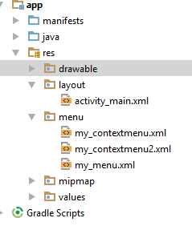
Context Menu Xml Code of MainActivity+contextMenuOne+ContextMenuTwo

Slide 13
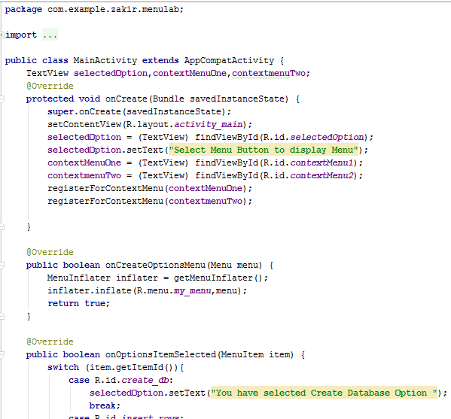
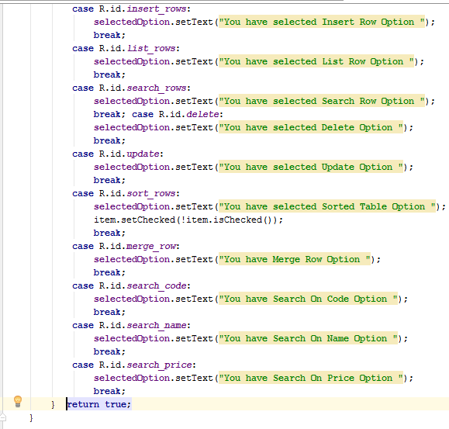
Context Menu Java Code

Slide 14
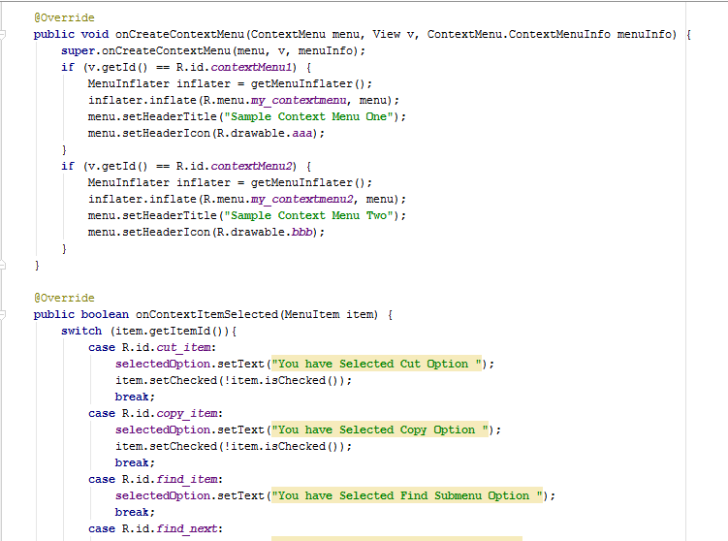
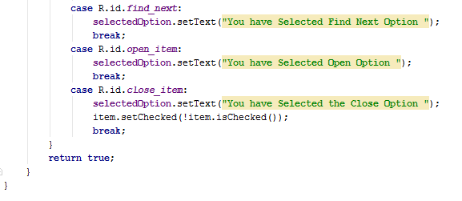
Context Menu Java Code Continue

Slide 15
Appling Context Menu to Listview
We have seen the implementation of context menu to the two textview controls. Instead of two textview control, let’s try creating a context menu for a listview control so that when the user taps and holds on any listview item, information about the item is displayed.
When we pressed on Listview item it will appear Menu

Slide 16

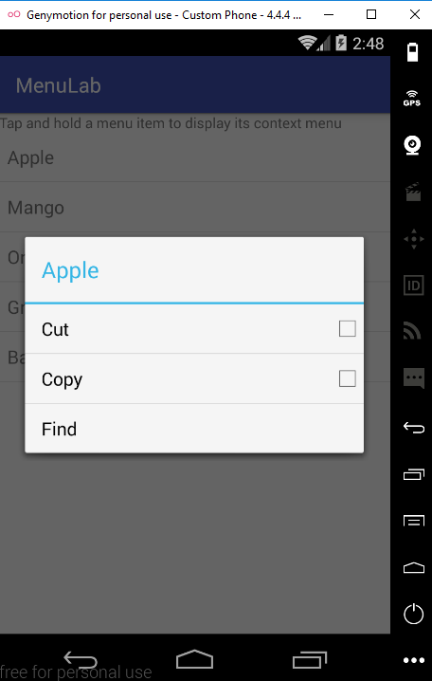

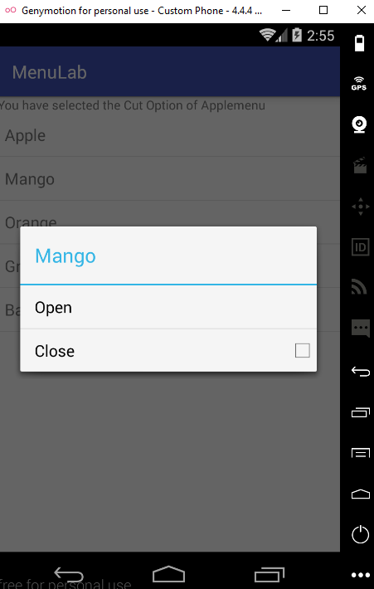
Screen shot

Slide 17
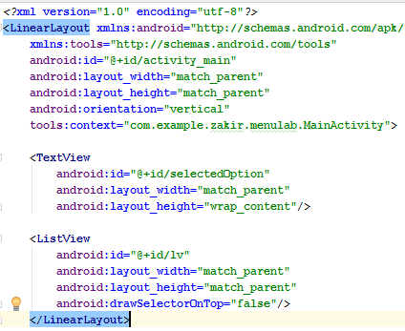
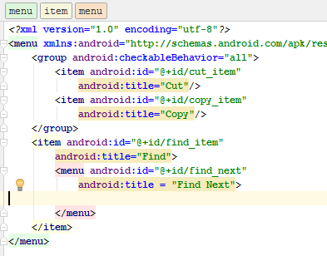
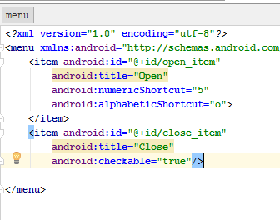
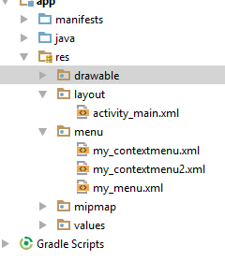
XML and JAVA code

Slide 18
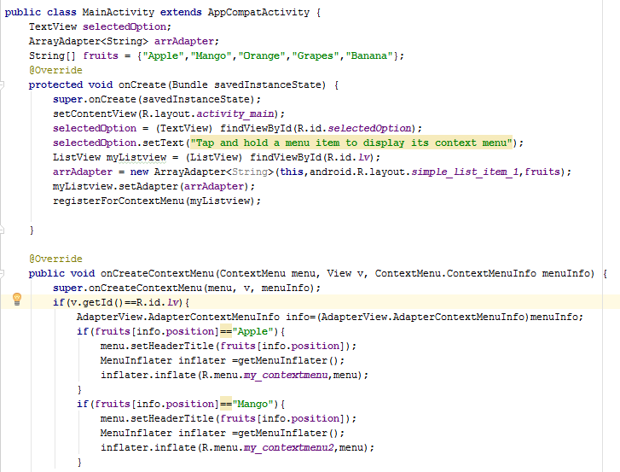
Java code

Slide 19
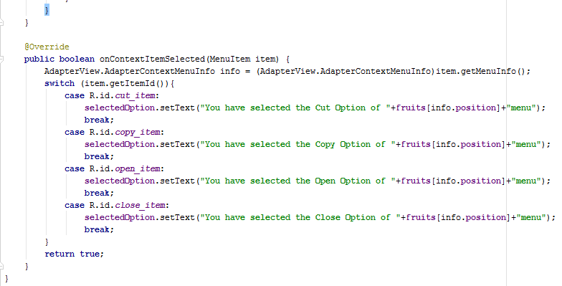
Java code Continue

Slide 20

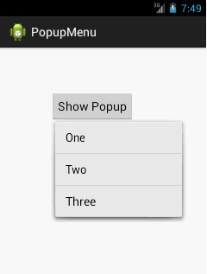
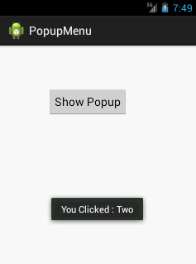
Pop UP menu Screen Shot

Slide 21
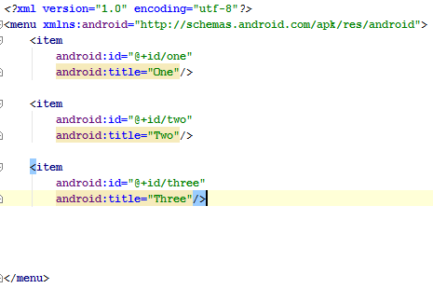
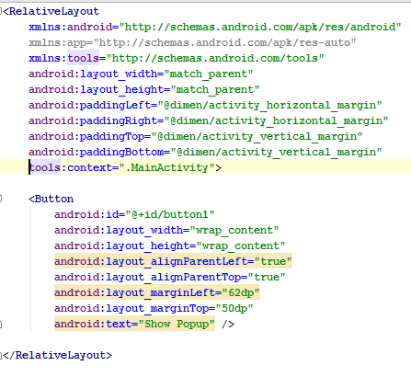
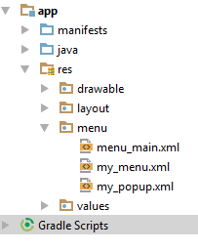
Pop UP menu XML Code

Slide 22
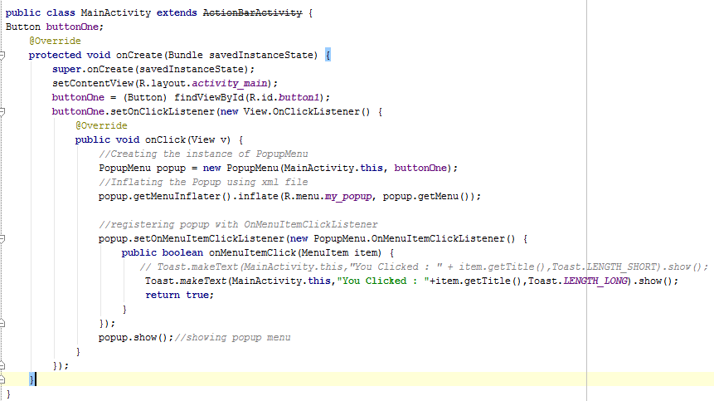
Pop UP menu Java Code

Slide 23
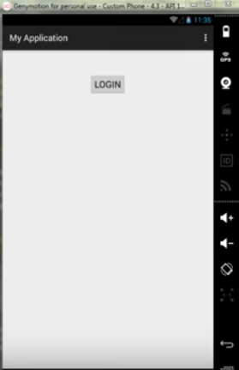
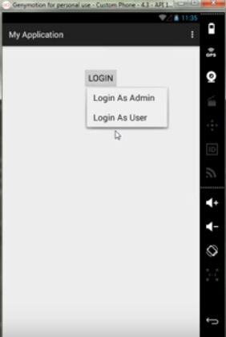
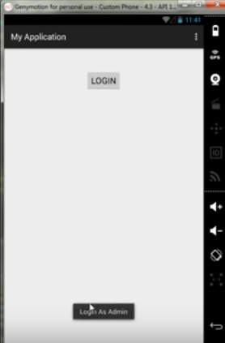
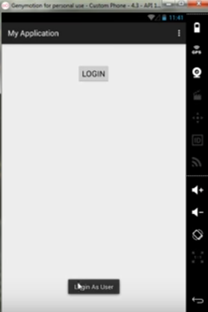
Pop UP menu Example 2

Slide 24
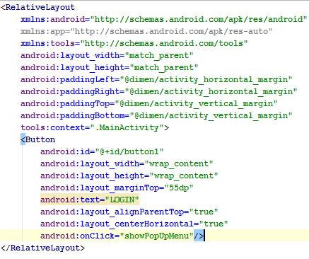
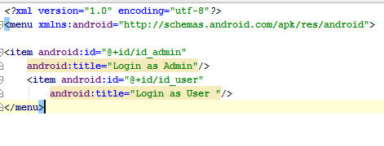
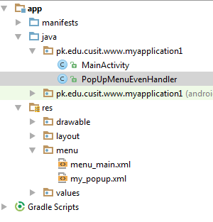
Pop UP menu Example 2 XML

Slide 25
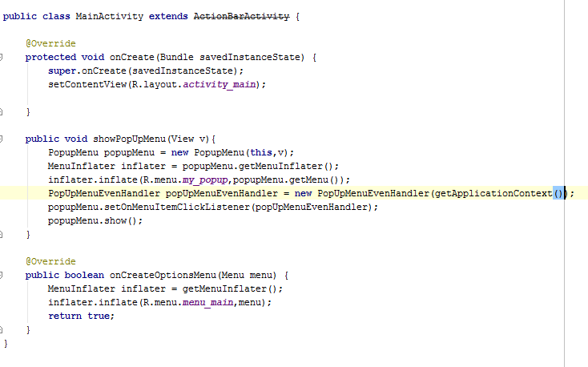
Pop UP menu Example 2 JAVA

Slide 26
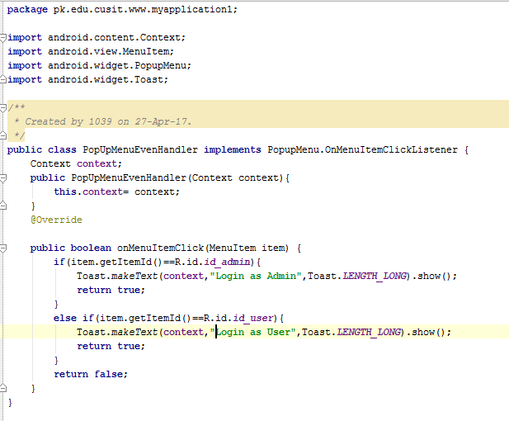
Pop UP menu Example 2 JAVA Class

Slide 27
Using the ActionBar
Action bar is a widget that replace the title bar at the top of every Activity displaying navigation and important functionality of an application.
By default the Action bar includes the application logo on the left side, followed by activity title, and menu items on the right side.
It provide a constant UI of an application.
It also used to provide a quick link to the application

Slide 28
Using the ActionBar Continue
Action bar provide the following features:
Customize the title bar of an activity
Follows its own life cycle.
Consistently displays frequently used actions of an application.
Appears in three standard forms: standard, tabbed, and list
Makes it possible to use the application icon or logo for navigation
Enabling the Actionbar
The action bar is enabled if an application uses default Theme.Holo theme and whose target SDK is 11 or higher
Example
<uses-sdk android:targetSdkVersion=“13” />

Slide 29
Displaying Action Items
To display menu items in the ActionBar as action item, we need to add an android:showAsAction attribute to the menu items while defining them in the menu file.
Always– makes the action item appear on the action bar
ifRoom--- make the action item appear in the action bar but only if there is room available on the action bar. If there is no room then item appear in the overflow menu
Never--- makes the menu item appear in the overflow menu

Slide 30
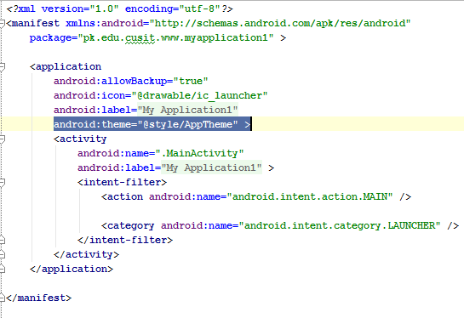


Check Manifest.xml

Slide 31

Displaying Action Screen Shot

Slide 32



How to Hide or show etc XML code

Slide 33

How to Hide or show etc XML code second Activity

Slide 34


How to Hide or show etc Java code MainActivity

Slide 35

How to Hide or show etc Java code second Activity

